Slide 1
Course Code CSC402 Course Name Analysis of Algorithms
Department of Computer Engineering
AY 2021-2022
MGMCET

Slide 2
Course Objectives
To provide mathematical approaches for Analysis of Algorithms
To understand and solve problems using various algorithmic approaches
To analyze algorithms using various methods
MGMCET

Slide 3
Course Outcome
Analyze the running time and space complexity of algorithms.
Describe, apply and analyze the complexity of divide and conquer strategy.
Describe, apply and analyze the complexity of greedy strategy.
Describe, apply and analyze the complexity of dynamic programming strategy.
Explain and apply backtracking, branch and bound.
Explain and apply string matching techniques.
MGMCET

Slide 4
Syllabus
Module 1 Introduction
Performance analysis, space, and time complexity Growth of function, Big-Oh, Omega Theta notation Mathematical background for algorithm analysis.
Complexity class: Definition of P, NP, NP-Hard, NP-Complete Analysis of selection sort, insertion sort.
Recurrences: The substitution method, Recursion tree method, Master method
Module 2 Divide and Conquer Approach
General method, Merge sort, Quick sort, Finding minimum and maximum algorithms and their Analysis, Analysis of Binary search.
MGMCET

Slide 5
Syllabus
Module 3 Greedy Method Approach
General Method, Single source shortest path: Dijkstra Algorithm Fractional Knapsack problem, Job sequencing with deadlines, Minimum cost spanning trees: Kruskal and Prim’s algorithms
Module 4 Dynamic Programming Approach
General Method, Multistage graphs, Single source shortest path: Bellman Ford Algorithm All pair shortest path: Floyd Warshall Algorithm, Assembly-line scheduling Problem0/1 knapsack Problem, Travelling Salesperson problem, Longest common subsequence
MGMCET

Slide 6
Syllabus
Module 5 Backtracking and Branch and bound
General Method, Backtracking: N-queen problem, Sum of subsets, Graph coloring
Branch and Bound: Travelling Salesperson Problem, 15 Puzzle problem
Module 6 String Matching Algorithms
The Naïve string-matching algorithm, The Rabin Karp algorithm, The Knuth-Morris-Pratt algorithm
MGMCET

Slide 7
books
Textbooks
T. H. Cormen, C.E. Leiserson, R. L. Rivest, and C. Stein, “Introduction to algorithms”, 2nd Edition, PHI Publication 2005.
Ellis Horowitz, Sartaj Sahni, S. Rajsekaran. “Fundamentals of computer algorithms” University Press
References:
Sanjoy Dasgupta, Christos Papadimitriou, Umesh Vazirani, “Algorithms”, Tata McGrawHill Edition.
S. K. Basu, “Design Methods and Analysis of Algorithm”, PHI
MGMCET

Slide 8
Module 1 Introduction
CE– SE–AOA
Dr. Anil Kale
Associate Professor
Dept. of Computer Engineering,
MGMCET
8

Slide 9
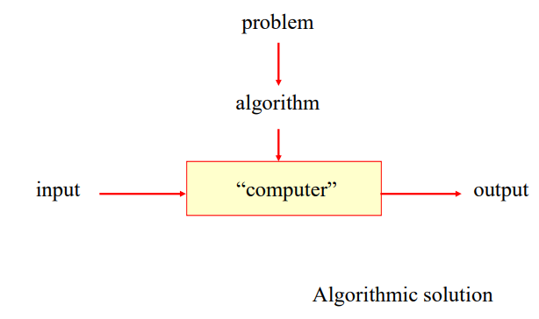
Notion of algorithm
MGMCET
9

Slide 10
Definitions of Algorithm
An algorithm is a sequence of unambiguous instructions for solving a problem, i.e., for obtaining a required output for any legitimate input in a finite amount of time.
A mathematical relation between an observed quantity and a variable used in a step-by-step mathematical process to calculate a quantity
Algorithm is any well defined computational procedure that takes some value or set of values as input and produces some value or set of values as output
A procedure for solving a mathematical problem in a finite number of steps that frequently involves repetition of an operation; broadly : a step-by-step procedure for solving a problem or accomplishing some end (Webster’s Dictionary)
MGMCET
10

Slide 11
What is the difference between program and algorithm?
Algorithm | Program
Design | Implementation
domain Knowledge | Programmer
Any language means English language | Programming language
Hardware and Software men's Operating System Independent | Dependent on Hardware and Operating System
Analyze | Testing
MGMCET
11

Slide 12
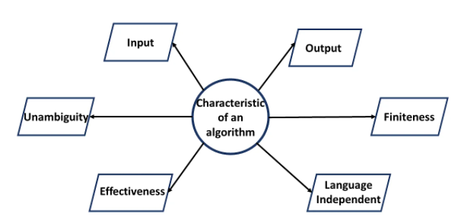
What are the characteristic of Algorithm
MGMCET
12

Slide 13
What are the characteristic of Algorithm
Recipe, process, method, technique, procedure, routine,… with following requirements:
Finiteness
terminates after a finite number of steps
2. Definiteness
rigorously and unambiguously specified
3. Input
valid inputs are clearly specified
Output
can be proved to produce the correct output given a valid input
Effectiveness
steps are sufficiently simple and basic
MGMCET
13

Slide 14
How to write an Algorithm
There are no well-defined standards for writing algorithms. It is, however, a problem that is resource-dependent. Algorithms are never written with a specific programming language in mind.
As you all know, basic code constructs such as loops like do, for, while, all programming languages share flow control such as if-else, and so on. An algorithm can be written using these common constructs.
Algorithms are typically written in a step-by-step fashion, but this is not always the case. Algorithm writing is a process that occurs after the problem domain has been well-defined. That is, you must be aware of the problem domain for which you are developing a solution.
Algorithm swap(a,b)
{
Temp = a;
A=b;
B=temp;
}
MGMCET
14

Slide 15
Algorithm swap(a,b)
{
Temp = a;
A=b;
B=temp;
}

Slide 17
How to Analyze an Algorithm
Algorithm analysis is defined as determining the efficiency and quality of the algorithm and then developing it better. The extent and quality of the algorithm are measured by two measures:
Space Complexity: The amount of memory needed by the program (from its operation to completion).
Time complexity: It is the amount of time needed to form and configure a program until it is finished.
Analyzing means predicting resources that algorithms requires , i.e.
Space complexity
How much space is required
Time complexity
How much time does it take to run the algorithm Often, we deal with estimates!
MGMCET
17

Slide 18
Frequency Count Method
1)
Algorithm sum(A,n)
{
S=0;
For(i=0; i<n; i++)
{
S=s+A[i];
}
Return s;
}
MGMCET
18

Slide 19
Frequency Count Method
2)
Algorithm add(A,B,n)
{
For(i=0; I<n; i++)
For(j=0; j<n; j++)
{
C[I,j]=A[I,j]+B[I,j];
}
}
MGMCET
19

Slide 20
Frequency Count Method
3)
Algorithm Mult(A,B,n)
{
For(i=0; i<n; i++)
For(j=0; j<n; j++)
{
C[i,j]=0;
{
For(k=0; k<n; k++)
{
C[i,j]=C[i,j]+A[i,k]+B[k,j];
}
}
}
MGMCET
20

Slide 21
Frequency Count Method
1)
For(i=0; i<n; i++)
{
statement;
}
2)
For(i=n; i>0; i--)
{
statement;
}
3)
For(i=0; i<n; i++)
For(j=0; j<n; j++)
{
statement;
}
MGMCET
21

Slide 22
Frequency Count Method
4)
For(i=0; i<n; i++)
For(j=0; j<i; j++)
{
statement;
}
MGMCET
22

Slide 23
Frequency Count Method
5)
P=0;
For(i=1; P<=n; i++)
{
P=P+i;
}
MGMCET
23

Slide 24
Frequency Count Method
6)
For(i=1; i<n; i=i*2)
{
statement;
}
MGMCET
24

Slide 25
Frequency Count Method
7)
For(i=n; i>=1; i=i/2)
{
statement;
}
MGMCET
25

Slide 26
Frequency Count Method
8)
For(i=0; i<n; i++)
For(j=0; j<n; j=j*2)
{
statement;
}
MGMCET
26

Slide 27
For(i=0; i<n; i++)
{
statement;
}
For(j=0; j<i; j++)
{
statement;
}

Slide 28
P=0;
For(i=1; i<n; i=i*2)
{
P=P+i;
}
For(j=1; j<P; j=j*2)
{
statement;
}

Slide 29
For(i=0; i<n; i++)
{
For(j=1; j<n; j=j/2)
{
statement;
}
}

Slide 31
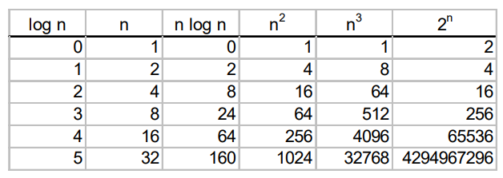
Types of function
O(1): constant
O(log2(n)): logarithmic
O(nlog(n)) : logarithmic
O(n): linear
O(n²): quadratic
O(n³): cubic
O(2^{n}): exponential
MGMCET
31

Slide 32
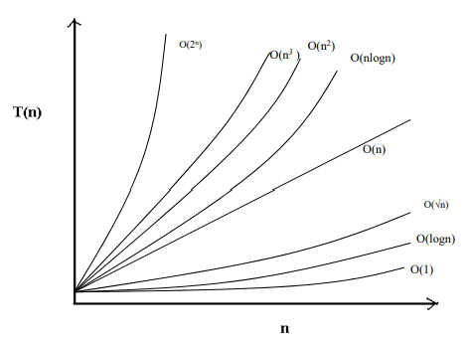
Types of function
MGMCET
32

Slide 33
ASYMPTOTICS NOTATIONS
O-notation (Big Oh) - Upper Bound
Ω-notation (Big–Omega) - lower bound
Θ-notation (Big–Theta) - tight bound
MGMCET
33

Slide 34
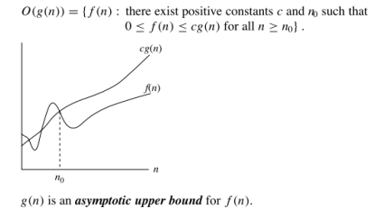
ASYMPTOTICS NOTATIONS
O-notation (Big Oh) - Upper Bound
MGMCET
34

Slide 35
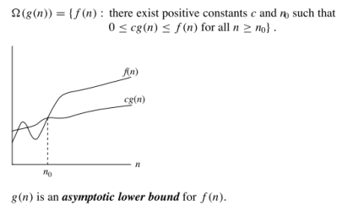
ASYMPTOTICS NOTATIONS
Ω-notation (Big–Omega) - lower bound
MGMCET
35

Slide 36
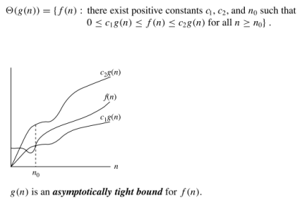
ASYMPTOTICS NOTATIONS
Θ-notation (Big–Theta) - tight bound
MGMCET
36

Slide 37
Best, Worst, Average Case Analysis
Best case Running Time: Searching key element present at first index.
Worst case Running Time: Searching key element present at last index.
Average case Running Time: All passible case time / number of cases
MGMCET
37

Slide 40
Recurrences
Recursion is generally expressed in terms of recurrences. In other words, when an algorithm calls to itself, we can often describe its running time by a recurrence equation which describes the overall running time of a problem of size n in terms of the running time on smaller inputs.
There are various techniques to solve recurrences.
Substitution Method:
Recursion Tree Method:
Master Method:
MGMCET
40

Slide 41
Recurrences
Void Test(int n)
{
if(n>0)
printf(‘%d’, n);
Test(n-1)
}
MGMCET
41

Slide 43
Recurrences
Void Test(int n)
{
if(n>0)
{
for (i=0; i<n; i++)
{
printf(‘%d’, n);
}
}
Test(n-1)
}
MGMCET
43

Slide 46
Recurrences
Void Test(int n)
{
if(n>0)
{
for (i=1; i<n; i=i*2)
{
printf(‘%d’, i);
}
}
Test(n-1)
}
MGMCET
46

Slide 48
Recurrences
Void Test(int n)
{
if(n>0)
printf(‘%d’, n);
Test(n-1);
Test(n-1);
}
MGMCET
48

Slide 50
T(n) = aT(n-b) + f(n), where a and b are the constants. a>0, b>0 and f(n)=O(n^k) where k≥0.

Slide 51
Recurrences
Master theorem for Decreasing function
General form for decreasing functions will be
T(n) = aT(n-b) + f(n), where a and b are the constants. a>0, b>0 and f(n)=O(n^k) where k≥0. a = Number of subproblems and b = The cost of dividing and merging the subproblems.
To solve this type of recurrence relation there are 3 cases :
Case : 1
If a = 1 then T(n) = O(n^(k+1)) or simply T(n) = O(n*f(n)).
Case : 2
If a>1 then T(n) = O(a^(n/b) * f(n)).
Case : 3
If a<1 then T(n) = O(n^k) or simply T(n) = O(f(n)).
MGMCET
51

Slide 52
Divide-and-Conquer
Algo DAC(P)
{
If (small (P))
{
return S(P)
}
else
{
Divide P into smaller instances P1 ,P2 ….Pk , k>=1
Apply DAC to each of these problem (DAC(P1 ), DAC(P2 )…DAC(Pk );
Return combine (DAC(P1 ), DAC(P2 )…DAC(Pk );
}
}
MGMCET
52

Slide 53
Recurrence Relation Dividing functions
Void Test(int n)
{
if(n>1)
printf(‘%d’, n);
Test(n/2);
}
MGMCET
53

Slide 54
Recurrence Relation Dividing functions
T(n) = 1 n=1
T(n/2) + 1 n>1
MGMCET
54

Slide 55
Recurrence Relation Dividing functions
Void Test(int n)
{
if(n>1)
{
for (i=0; i<n; i++)
{
printf(‘%d’, n);
}
}
Test(n/2);
Test(n/2);
}
MGMCET
55

Slide 57
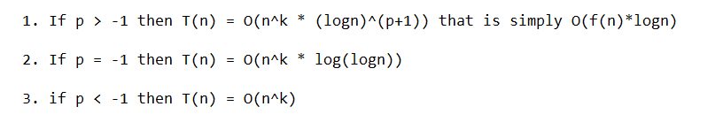
Recurrence Relation Dividing functions
Master theorem for Dividing functions
The general form for the dividing functions :
T(n) = aT(n/b) + f(n), where a and b are constants. a≥1, b>1 and f(n) can be expressed as O(n^k * (logn)^p). a = Number of subproblems and b = The cost of dividing and merging the subproblems.
To find the time complexity for these kinds of functions again there are 3 cases. Here we have to find two things 1. loga base b and 2. k
For simplicity, let’s take loga base b as x for all below cases.
Case : 1
If k < x then T(n) = O(n^x).
Case : 2
If k = x then again some cases here comes p in the picture :
Case : 3
If k > x then T(n) = O(f(n)).
MGMCET
57

Slide 59
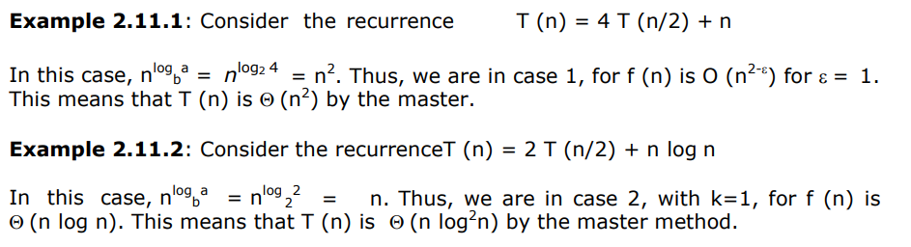
Recurrence Relation Dividing functions
Consider the recurrence T (n) = 4 T (n/2) + n
Consider the recurrenceT (n) = 2 T (n/2) + n log n
consider the recurrenceT (n) = T (n/3) + n
Consider the recurrence T (n) = 9 T (n/3) + n ^2.5
MGMCET
59

Slide 60
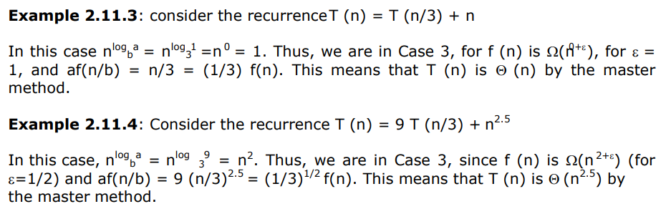
60

Slide 61
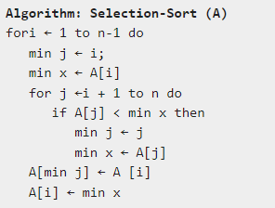
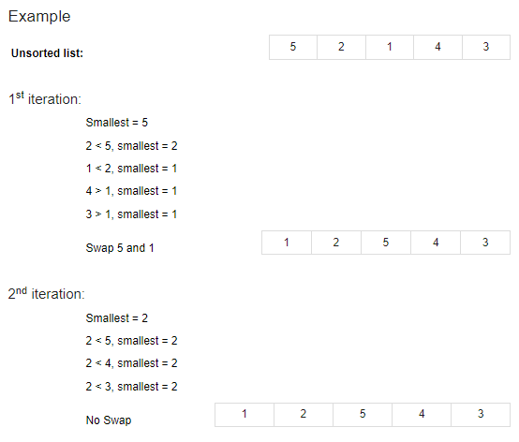
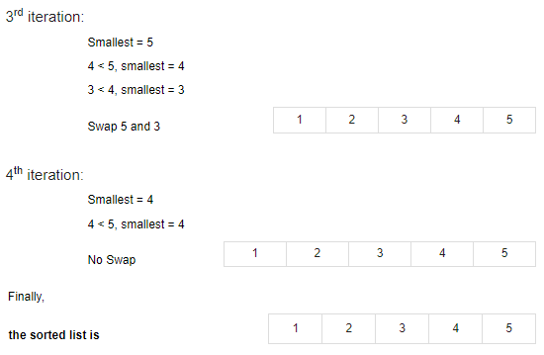
Analysis of selection sort.
For each i from 1 to n - 1, there is one exchange and n - i comparisons, so there is a total of n - 1 exchanges and
(n − 1) + (n − 2) + ...+ 2 + 1 =
n(n − 1)/2 comparisons.
MGMCET
61

Slide 62
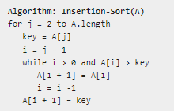
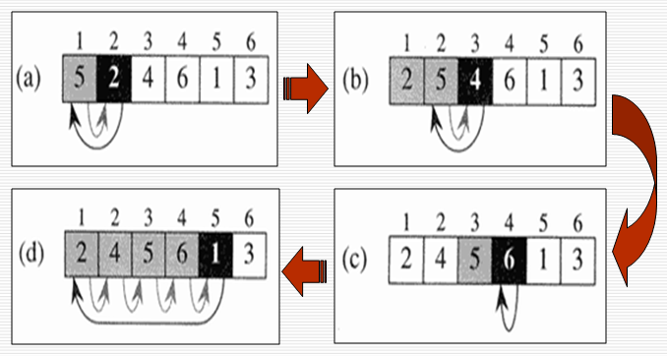
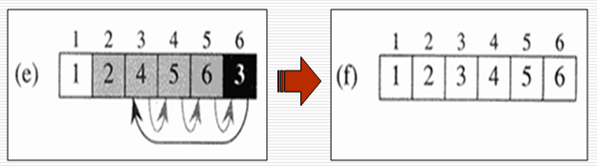
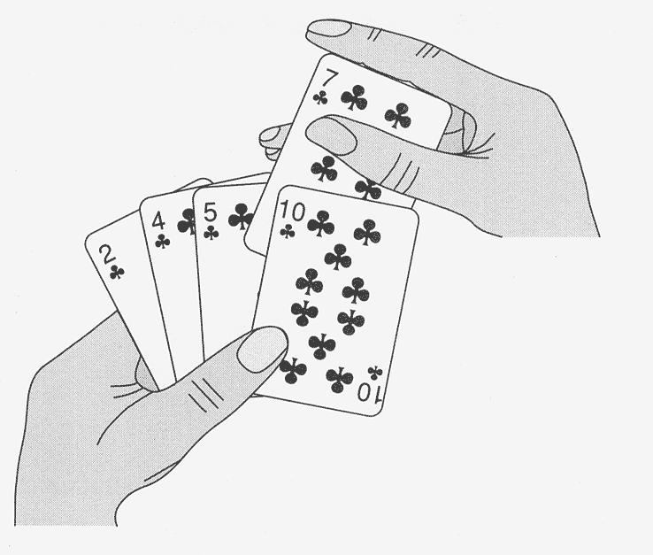
Analysis of insertion sort.
Analysis
Run time of this algorithm is very much dependent on the given input.
If the given numbers are sorted, this algorithm runs in O(n) time. If the given numbers are in reverse order, the algorithm runs in O(n²) time.
MGMCET
62

Slide 63
Types of Complexity Classes P, NP, NP hard and NP complete
In computer science, there exist some problems whose solutions are not yet found, the problems are divided into classes known as Complexity Classes. In complexity theory, a Complexity Class is a set of problems with related complexity. These classes help scientists to groups problems based on how much time and space they require to solve problems and verify the solutions. It is the branch of the theory of computation that deals with the resources required to solve a problem.
Complexity classes are useful in organizing similar types of problems.
Types of Complexity Classes
This article discusses the following complexity classes:
P Class
NP Class
NP hard
NP complete
MGMCET
63

Slide 64
Types of Complexity Classes P, NP, NP hard and NP complete
P Class
The P in the P class stands for Polynomial Time. It is the collection of decision problems(problems with a “yes” or “no” answer) that can be solved by a deterministic machine in polynomial time.
Features:
The solution to P problems is easy to find.
P is often a class of computational problems that are solvable and tractable. Tractable means that the problems can be solved in theory as well as in practice. But the problems that can be solved in theory but not in practice are known as intractable.
This class contains many natural problems like:
Calculating the greatest common divisor.
Finding a maximum matching.
Decision versions of linear programming.
MGMCET
64

Slide 65
Types of Complexity Classes P, NP, NP hard and NP complete
NP Class
The NP in NP class stands for Non-deterministic Polynomial Time. It is the collection of decision problems that can be solved by a non-deterministic machine in polynomial time.
Features:
The solutions of the NP class are hard to find since they are being solved by a non-deterministic machine but the solutions are easy to verify.
Problems of NP can be verified by a Turing machine in polynomial time.
Example:
Let us consider an example to better understand the NP class. Suppose there is a company having a total of 1000 employees having unique employee IDs. Assume that there are 200 rooms available for them. A selection of 200 employees must be paired together, but the CEO of the company has the data of some employees who can’t work in the same room due to some personal reasons. This is an example of an NP problem. Since it is easy to check if the given choice of 200 employees proposed by a coworker is satisfactory or not i.e. no pair taken from the coworker list appears on the list given by the CEO. But generating such a list from scratch seems to be so hard as to be completely impractical.
It indicates that if someone can provide us with the solution to the problem, we can find the correct and incorrect pair in polynomial time. Thus for the NP class problem, the answer is possible, which can be calculated in polynomial time.
This class contains many problems that one would like to be able to solve effectively:
Boolean Satisfiability Problem (SAT).
Hamiltonian Path Problem.
Graph coloring.
MGMCET
65

Slide 66
Types of Complexity Classes P, NP, NP hard and NP complete
NP-hard class
An NP-hard problem is at least as hard as the hardest problem in NP and it is the class of the problems such that every problem in NP reduces to NP-hard.
Features:
All NP-hard problems are not in NP.
It takes a long time to check them. This means if a solution for an NP-hard problem is given then it takes a long time to check whether it is right or not.
A problem A is in NP-hard if, for every problem L in NP, there exists a polynomial-time reduction from L to A.
Some of the examples of problems in Np-hard are:
Halting problem.
Qualified Boolean formulas.
No Hamiltonian cycle.
MGMCET
66

Slide 67
Types of Complexity Classes P, NP, NP hard and NP complete
Complexity Class | Characteristic feature
P | Easily solvable in polynomial time.
NP | Yes, answers can be checked in polynomial time.
Co-NP | No, answers can be checked in polynomial time.
NP-hard | All NP-hard problems are not in NP and it takes a long time to check them.
NP-complete | A problem that is NP and NP-hard is NP-complete.
MGMCET
67

Slide 68
Thanks

